Slide 1
Drinking alcohol detection

Slide 2
Members of team :
Mohamed ragab Mohamed moussa 20221454736
omar sameh said hamed shamakh 20221441786
Anas bakr Mohamed 20221042720

Slide 3
Overview of our Data
We are choose the data as to match requirement of the project and high usability from others that let we know the data is good for using to detect and we will get good result
This dataset is collected from National Health Insurance Service in Korea. All personal information and sensitive data were excluded.
The purpose of this dataset is to:
Analysis of body signal
Classification of smoker or drinker

Slide 4
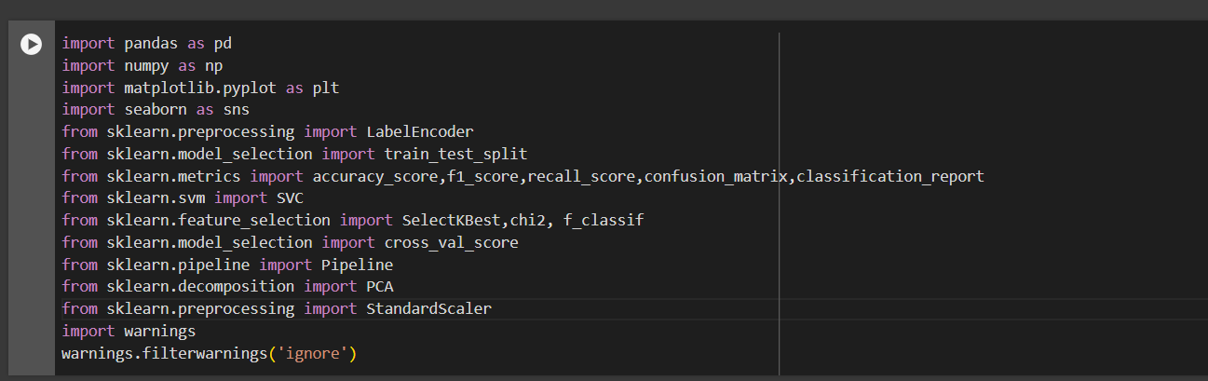
Librarys we use in our project

Slide 5
Pandas : to read data as csv file
Numpy : numerical computing that provides support for large, multi-dimensional arrays and matrices, along with a collection of mathematical functions to operate on these arrays efficiently.
Matplotlib : for visualization in our data and set the size and label for each graph
Seaborn : also this for visualization It provides a high-level interface for creating attractive and informative statistical graphics
sklearn.preprocessing import LabelEncoder : to convert the string data in numeric so we can train the model
from sklearn.model_selection import train_test_split : for split the data for x train , y train , x test , y test
from sklearn.metrics import accuracy_score,f1_score,recall_score,confusion_matrix,classification_report :
To evaluate our model with accuracy and recall and f1 score and confusion matrix and classification report
from sklearn.svm import SVC : for using the support vector machine to train our data
from sklearn.feature_selection import SelectKBest,chi2 : use it for a feature selection and chi2 for get the best featue from the data as a test

Slide 6

from sklearn.decomposition import PCA : use it for apply the principle component analysis technique in our data
from sklearn.preprocessing import StandardScaler : to scale our data to get faster when we got to train the model
import warnings : for ignore any notification for update in python 3
Let’s start the trip and explore data

Slide 7
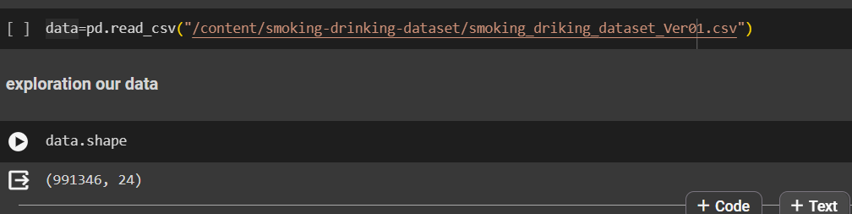
There is we read the data and get the shape of it
It have a large shape so we can’t train all of this

Slide 8
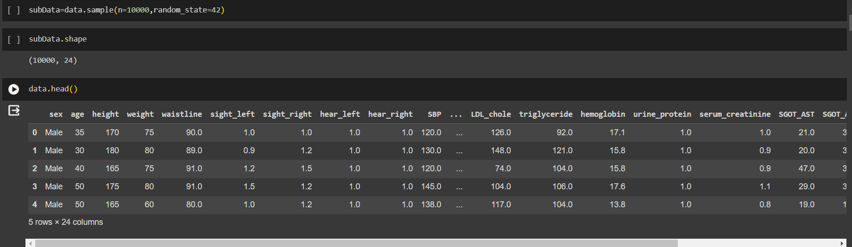
There is we get a sample of the data to work on it and this is a head of data

Slide 9
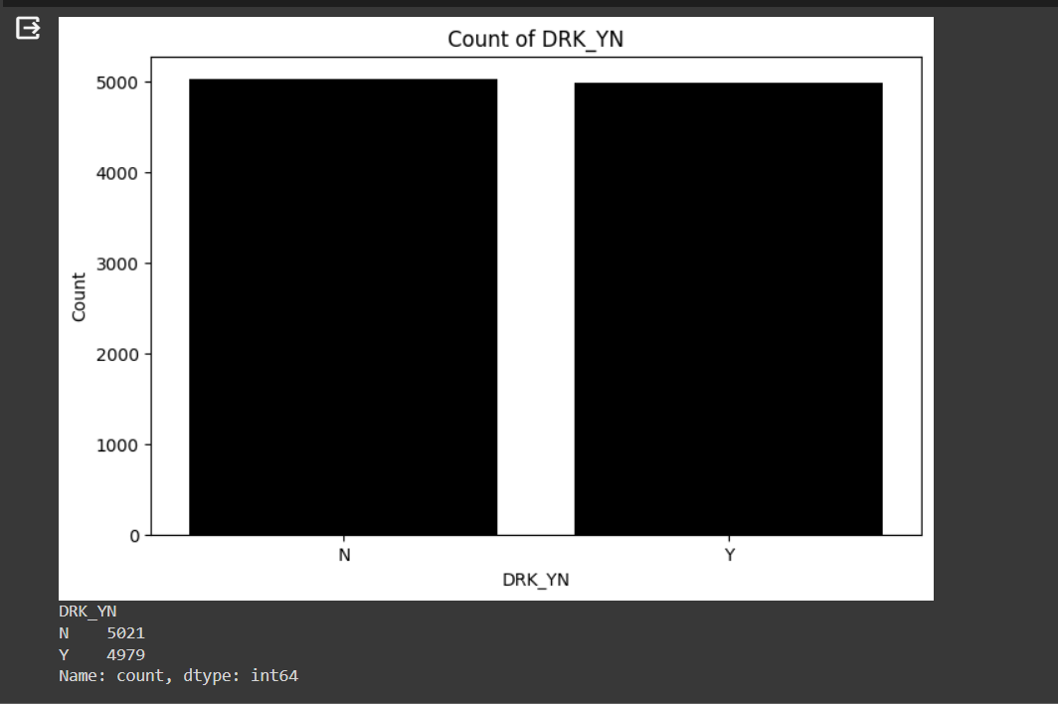
That the graph of target output of data to make sure it is a balned and not bias data

Slide 10
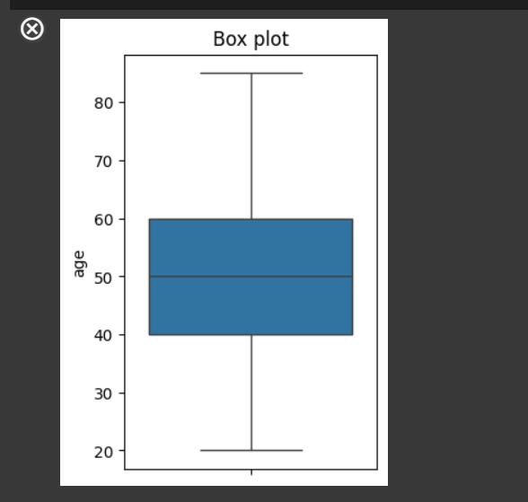
Boxplot
This is for age column we show that the a lot of data have a age between 40 to 60

Slide 11
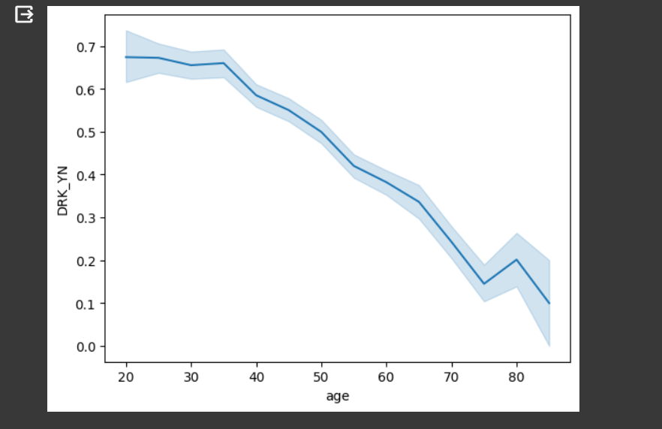
This is a line plot between age and the target output as drinking or not we know that of our graph when the person get older he is not drinking opposite to as he younger

Slide 12
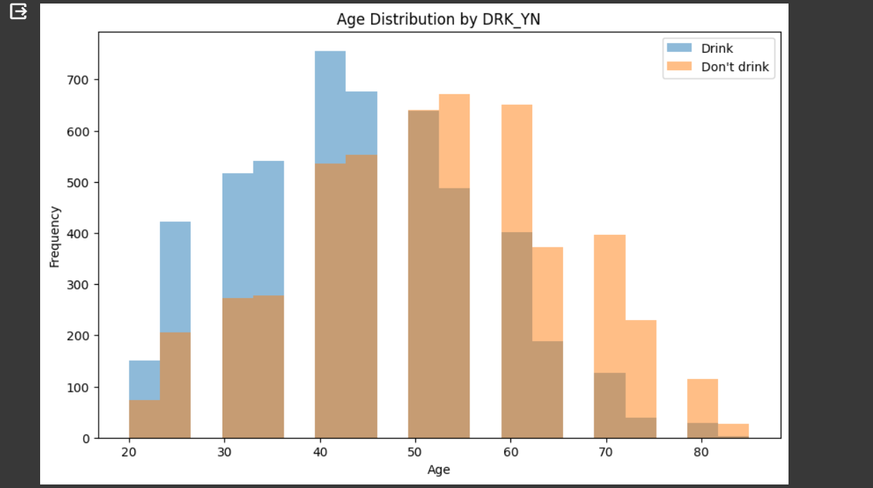
This is an age distribution by drinking
As we shown the most age drinking almost 41 till 43 and after 50 tears old drinking is decrease

Slide 13
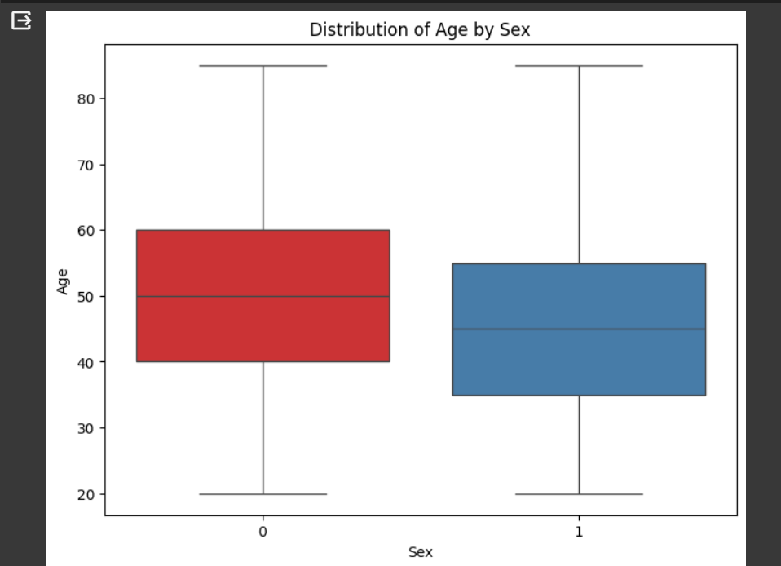
This is the box plot of the age and sex as we shown the average age of female as bigger than male

Slide 14
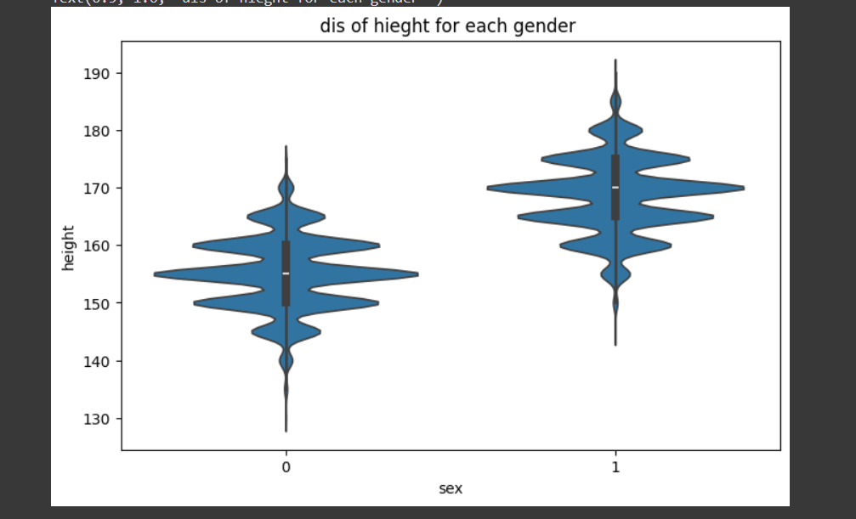
violin plot for two column height for each gender as we shown the average of height for male bigger than female as a normality in the real life

Slide 15
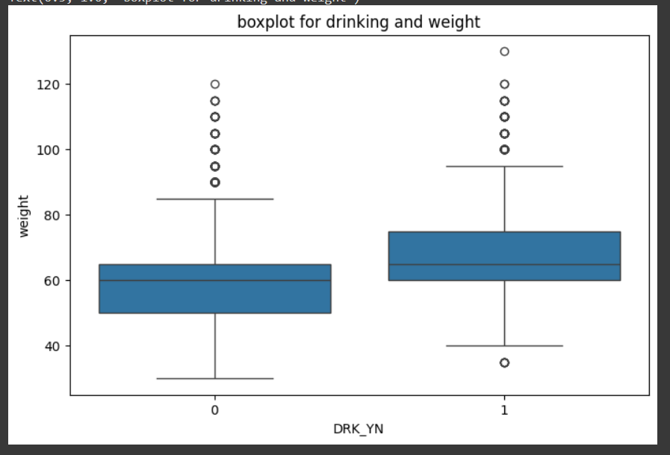
We conclude that from this box plot drinking is affected of the person weight is get you gain more weight than the person not drinking

Slide 16
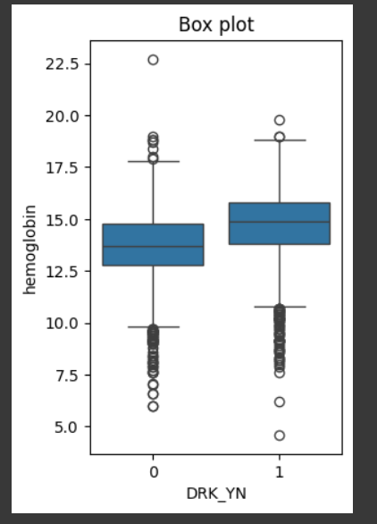
Hemoglobin in the drinking people
Is bigger than the normal person the higher of hemoglobin it’s driven to Increased Blood Viscosity

Slide 17
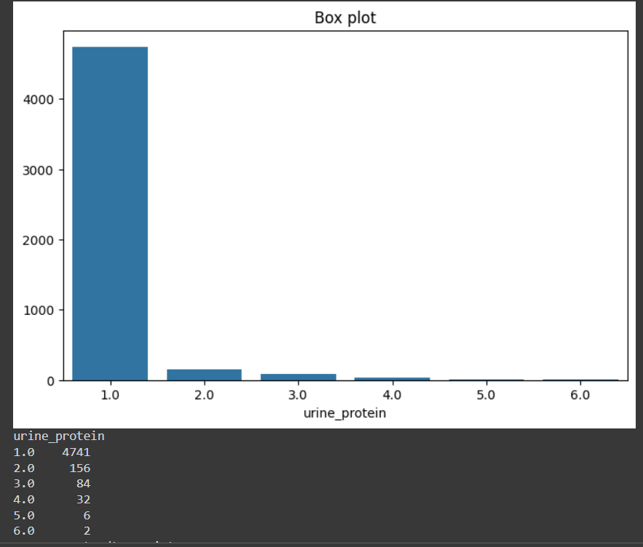
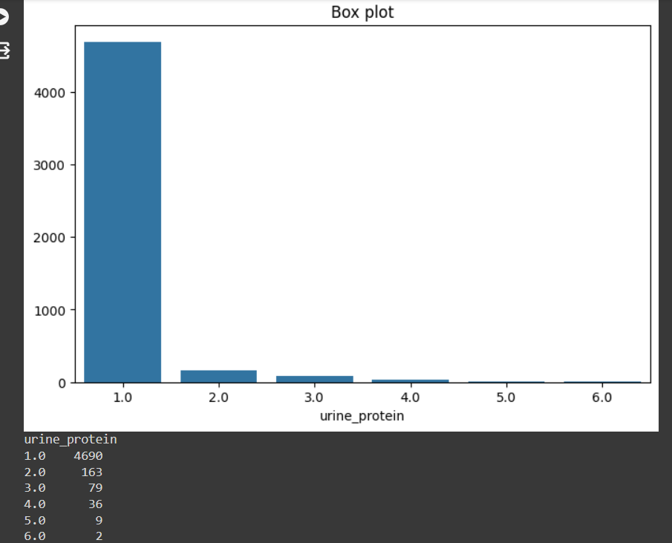
There is the protein in urine for drinking people and not drinking people this is like a same values in two graph so drinking is not affected in the protein in urine

Slide 18
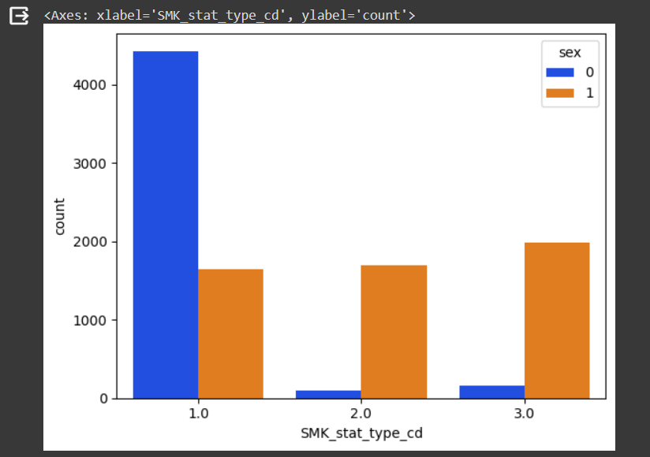
The smoking history for each gender 1 refer to not smoking ever 2 is smoking quiet 3 smoking a lot for a long time
As we shown a little of female is smoking compared by male

Slide 19
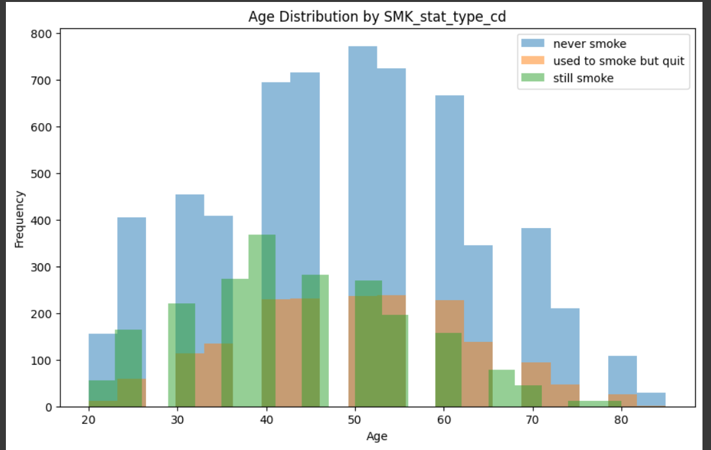
Age distribution by smoking history for all data as we shown the age have a high frequency of smoking almost 39 years old and the non smoking people in data is a lot

Slide 20
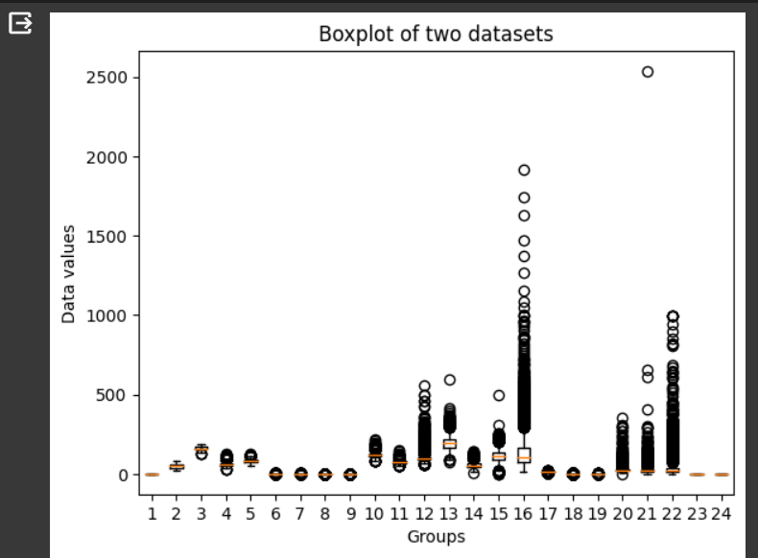
This is a box plot for all data is have a outliers in column 16 ,21,13 and 15
so we will do a function to transform outliers

Slide 21
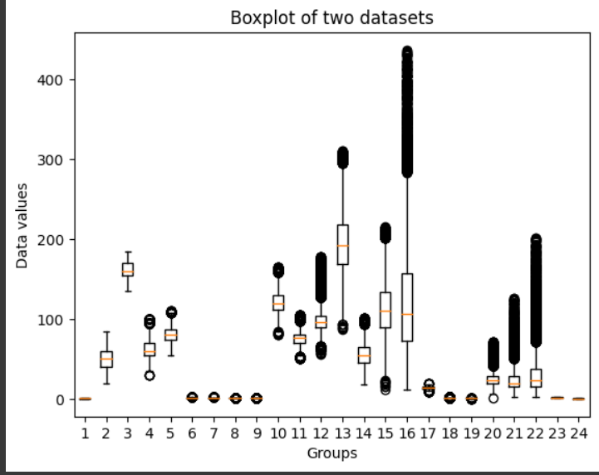
After we got transform the outliers with mean this is a box plot of the data

Slide 22
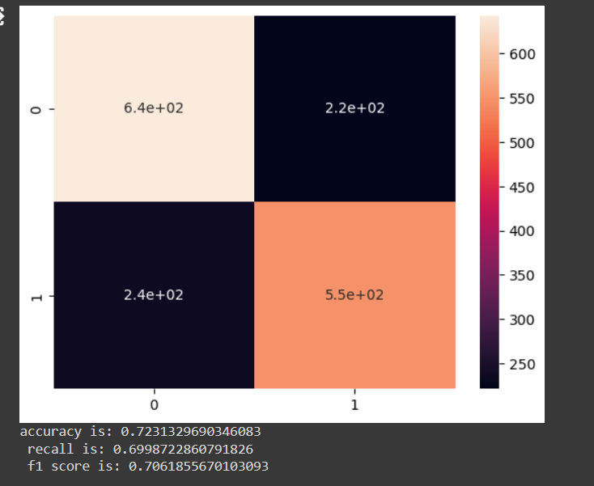
Confusion matrix for support vector machine model after we use feature selection we got this result

Slide 23
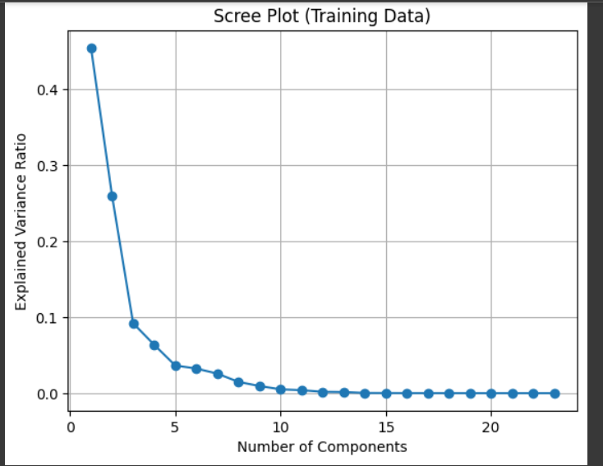
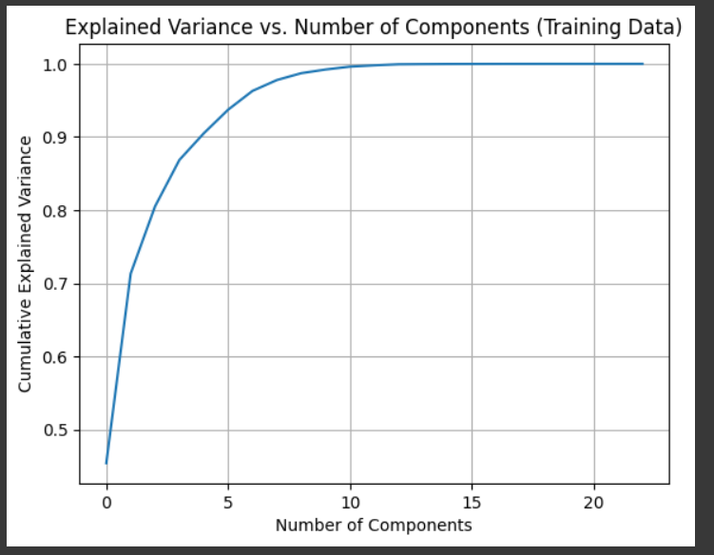
We will try PCA technique to increase accuracy model so we should have decide the optimal number of n component so we use cumulative explained variance ratio and scree plot for training data to decide the number of component

Slide 24
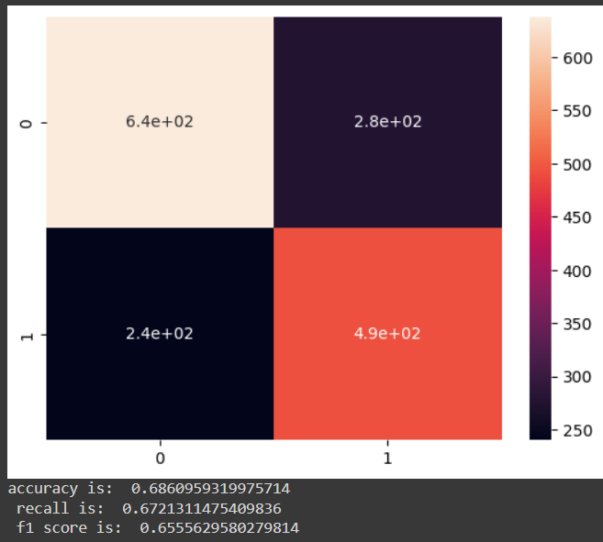
Confusion matrix after we apply dimensionality reduction using principle component analysis

Slide 25
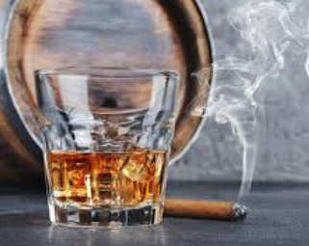
Here you will find the source code :
https://colab.research.google.com/drive/1M02abwI0JXBFzcPSZSzQ8dBDx-geP_JD?usp=sharing
Thanks in advance

